Slide 1


Constituency Connect
Group Members:
Muhammad Ahsan 21-ARID-737
Haseeb Ur Rehman 21-ARID-715
Huzaifa Bin Shahzad 21-ARID-719
Supervised By:
Ms. Farkhanda Qamar
UNIVERSITY INSTITUTE OF INFORMATION TECHNOLOGY

Slide 2
Table of Contents
Introduction
Literature Review
Benchmarking
Problem Statement
Proposed Model/Solution
Scope
Tools and Technologies
Final Outcome

Slide 3
Introduction
Constituency Connect is a web-based application designed to improve communication between constituents (citizens) and their elected representatives.
The platform enables users to report complaints, participate in surveys, track performance, and engage with representatives through real-time updates and virtual meetups.
Core Idea
Provide a seamless, transparent, and efficient channel for citizens to voice their concerns, track issues, and hold representatives accountable for actions and resolutions.

Slide 4
Introduction
Key Features
Complaint Reporting: Allows users to file complaints and track progress.
Performance Tracking: Track the performance of representatives with data visualizations.
Real-Time Updates: Stay informed with live updates on complaint statuses, event notifications, etc.
Virtual Meetups: Enable citizens to engage in video conferencing sessions with representatives.
Surveys and Polls: Gather feedback on public issues through interactive surveys and polls.

Slide 5
Literature Review
FixMyStreet:
FixMyStreet is a web-based platform that allows citizens to report public service issues (potholes, streetlights, etc.) directly to local authorities, improving local governance and transparency.
Features:
Location-based reporting
Reports are visible to everyone, encouraging public accountability.
Easy-to-use interface for submitting complaints.
Many local authorities integrate FixMyStreet into their internal systems, allowing for automated workflows and streamlined complaint handling.

Slide 6
Literature Review
Shortcomings:
Focus mainly on infrastructure problems, missing broader community engagement features like surveys or virtual meetups.
Does not offer real-time updates and performance tracking for representatives.
Technologies:
jQuery
RequireJS
Nginx

Slide 7
Literature Review
SeeClickFix
SeeClickFix is a platform that allows citizens to report non-emergency issues in their neighborhoods and engage with local governments for resolution.
Features:
Mobile and Web App for easy access and issue reporting.
Direct interaction between citizens and officials, allowing users to receive feedback on the progress of their complaints.
Map-based tracking of problems.

Slide 8
Literature Review
Shortcomings:
Primarily focuses on physical infrastructure issues rather than broader civic engagement.
Lacks features for virtual engagement (like virtual meetups/surveys).
Limited feedback mechanisms for performance tracking
Technologies:
Bootstrap
jQuery
Ruby on Rails
Nginx

Slide 9
Literature Review
Neighbourland
Neighbourland is a civic engagement tool that empowers residents to collaborate on ideas for improving public spaces and local governance.
Features:
Citizens can propose and discuss ideas to improve their neighborhoods, helping to shape government projects and decisions.
Surveys and polls for gathering community opinions.
Focuses on community-driven projects, allowing citizens to follow the progress of initiatives they care about.

Slide 10
Literature Review
Shortcomings:
Focuses on long-term project-based collaboration rather than short-term problem reporting or complaint resolution.
Lacks real-time features such as live tracking or updates.
No Role-Based Access Control(RBAC) or performance monitoring for local representatives.
Technologies:
Typescript
Apollo JS
Node JS
Nginx

Slide 11
Literature Review
PM Citizen Portal
The PM Citizen Portal is a government-run platform in local landscape designed for citizens to submit complaints and track their resolution by relevant departments.
Features:
Provides a single point for citizens to submit complaints on various issues.
Citizens can track the status of their complaints and receive updates when an issue is resolved.
Integrated with multiple government departments for quick resolution.

Slide 12
Literature Review
Shortcomings:
Lacks real-time notifications and transparency features like performance dashboards for representatives.
Offers basic reporting but lacks detailed analytics and customizable reports for data-driven decision-making.
Unlike more modern platforms, it does not offer virtual meetups, or survey tools to foster direct communication between citizens and representatives.
Technologies:
Bootstrap
jQuery
php

Slide 13
Literature Review
Conclusion
While each system offers valuable civic engagement tools, none fully combine the features of real-time tracking, virtual engagement (meetups, surveys), and performance analytics.
FixMyStreet and SeeClickFix focus on public service infrastructure issues but miss the broader aspects of civic engagement and representative accountability.
Neighbourland fosters long-term collaboration on public projects but lacks features for addressing immediate concerns or complaints.
PM Citizen Portal provides a centralized complaint system but misses out on modern features like real-time updates, detailed analytics, and dynamic civic engagement tools.

Slide 14
Benchmarking
Features | Constituency Connect | PM Citizen Portal | FixMyStreet | SeeClickFix | Neighbourland
Complaint Reporting | Yes | Yes | Yes | Yes | No
Complaint Prioritization | Yes | No | No | No | No
Virtual Meetups | Yes | No | No | No | Yes
Surveys | Yes | No | No | No | Yes
Event Calendar | Yes | No | No | No | No
Multi Language Support | Yes | Yes | No | No | No
Performance Metrics | Yes | No | No | No | No

Slide 15
Problem Statement
Although various complaint management systems exist, significant gaps remain in effectively connecting constituents with their representatives. Current communication channels often lack real-time interaction, causing delays in complaint resolution and weakening civic engagement. This results in slow problem resolution, reduced accountability, and a growing disconnect between representatives and the public. Citizens struggle to file complaints, track progress, or receive timely responses, highlighting the need for a unified solution that improves communication, transparency, and governance.

Slide 16
Proposed Solution
Problem Solution
Constituency Connect bridges communication gaps between constituents and elected representatives by:
Enabling constituents to submit complaints, track progress, and interact with representatives and departments.
Providing multiple communication channels, such as virtual meetings, surveys, and complaint tracking.
Including features like real-time notifications, performance tracking, and multi-language support.

Slide 17
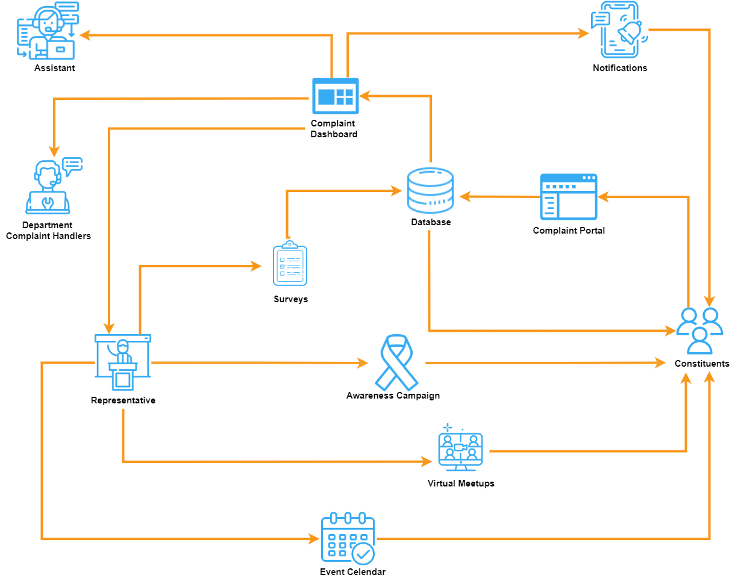
Proposed Solution
Model Diagram

Slide 18
Scope
Focus on complaint submission, tracking, and resolution.
Supports virtual meetups and performance monitoring of representatives.
Caters to multiple user roles: constituents, representatives, assistants, and department officials.
Provides a bilingual interface (English and Urdu).
Excludes features like external application integration and general-purpose community forums.

Slide 19
Tools and Technologies
Tools
Visual Studio Code(VS Code): Lightweight code editor with extensions.
Figma: Design tool for collaborative UI/UX creation.
Miro: Collaborative whiteboard platform for mind mapping.
Draw.io: Diagramming tool for flowcharts and architecture.
Adobe Illustrator: Vector graphics editor for designs.

Slide 20
Tools and Technologies
Frontend Technologies
HTML5 | React JS
CSS3 | Redux Toolkit
Tailwind CSS | Material UI
Bootstrap | React Hook Form
JavaScript | TanStack Query
Backend Technologies
Node JS | Express JS

Slide 21
Tools and Technologies
Database
MongoDB | Mongoose
Authentication and Authorization
Clerk

Slide 22
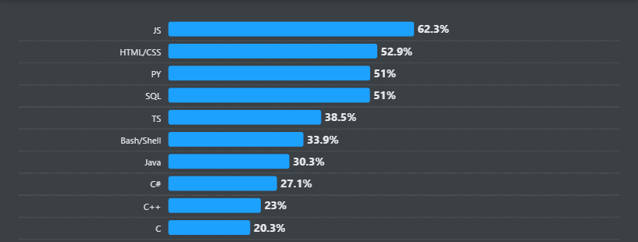
Tools and Technologies
Stack Overflow Survey

Slide 23
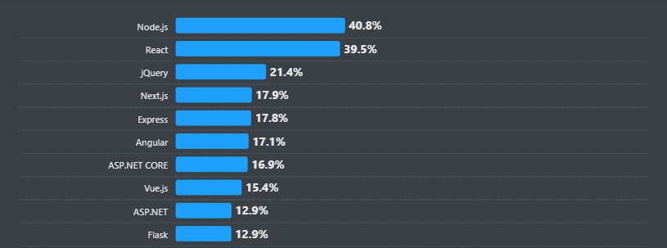
Tools and Technologies
Stack Overflow Survey

Slide 24
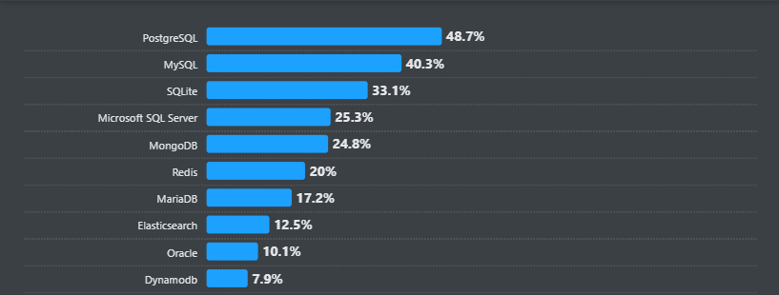
Tools and Technologies
Stack Overflow Survey

Slide 25
Final Outcome
Streamlines communication between constituents and elected representatives.
Facilitates real-time interactions, complaint submission, and tracking.
Provides transparent monitoring of representatives' performance.
Promotes transparency and accountability through real-time notifications.
Encourages meaningful civic engagement by addressing communication gaps

Slide 26
References
https://www.fixmystreet.com/
https://seeclickfix.com/
https://neighborland.com/
https://web.citizenportal.gov.pk/
https://www.wikipedia.org/
https://survey.stackoverflow.co/2024/

Slide 27


